Slide 1
Statistics and Reliability: Module 9
Measurement Systems Analysis (MSA)
Notes:
Module Topics
Gage Repeatability & Reproducibility (R&R)
Linearity
Copyright (c) Deere & Company, as an unpublished work. This material is the property of Deere & Company. All use, disclosure, and/or reproduction not specifically authorized by Deere & Company is prohibited.

Slide 2
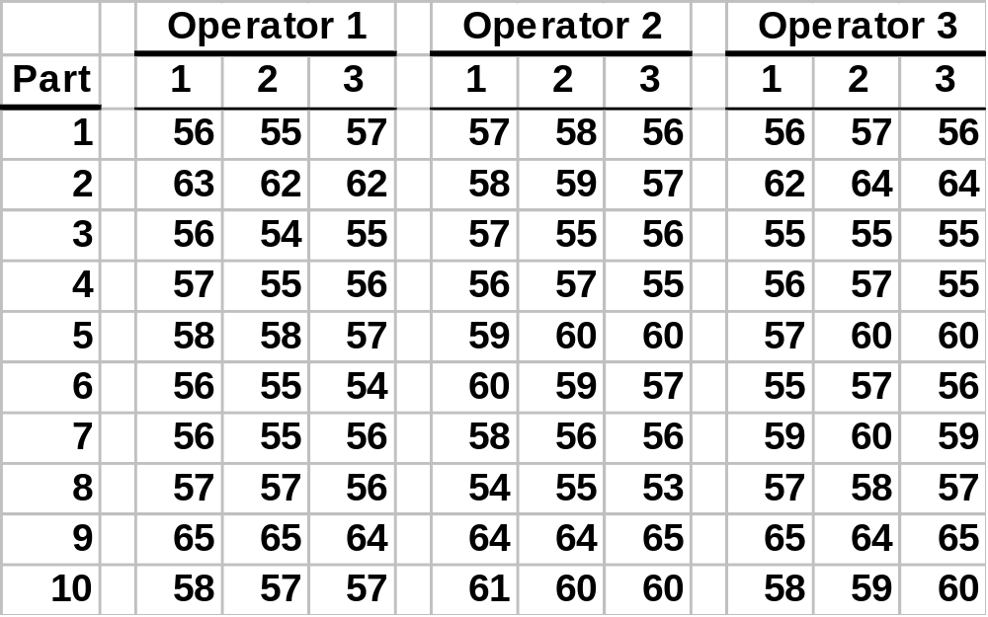
Classic Gauge R&R Study
Notes:
Types of Errors
Errors due to modeling assumptions
Errors due to using an approximate method of solution
Errors due to carrying out inexact arithmetic, i.e. rounding errors
Errors in the data
[Guide to Mathematical Modeling, Dilwyn Edwards & Mike Hamson, p. 118-119]
Plus there are errors in the measurement system.
Here’s a classic Gage R&R Study with 3 Operators, 10 Parts, 3 Trials per operator-part combination.

Slide 3
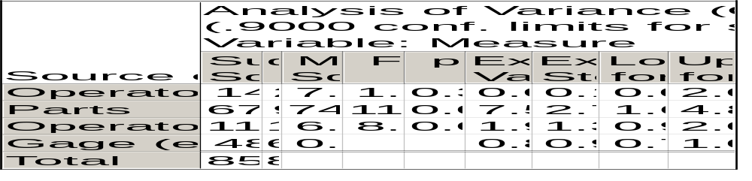
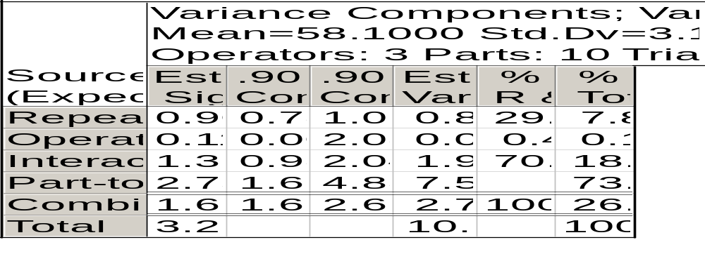
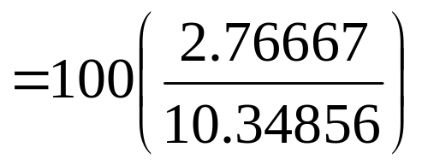
Classical Gauge R&R ANOVA
Notes:
We would report that the Combined R&R is 26.7% based on the ratio of Combined R&R variance (2.76667 = 0.81111 + 0.01317 + 1.94239) to total variance (10.34856).

Slide 4
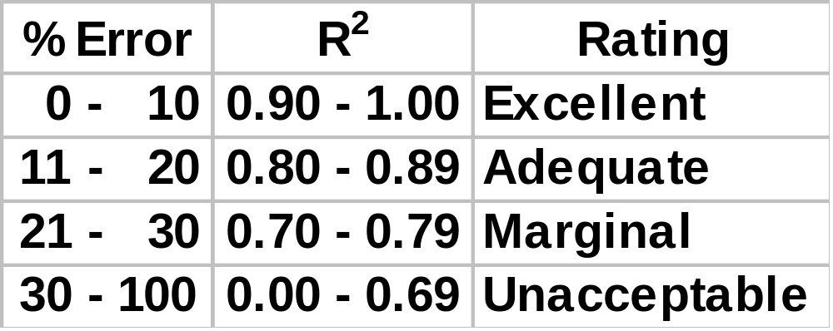
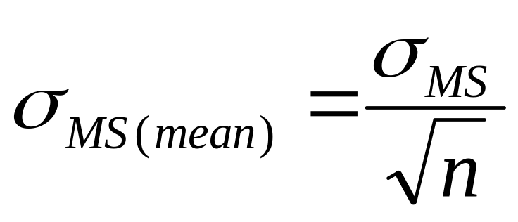
Measurement System Criteria
Central Limit Theorem Practical Application
Notes:
MS = Measurement System
We usually rely on 1 reading from a measurement system to estimate our input or output variable values.
An easy way to reduce measurement system error is to average 2 or more readings.

Slide 5
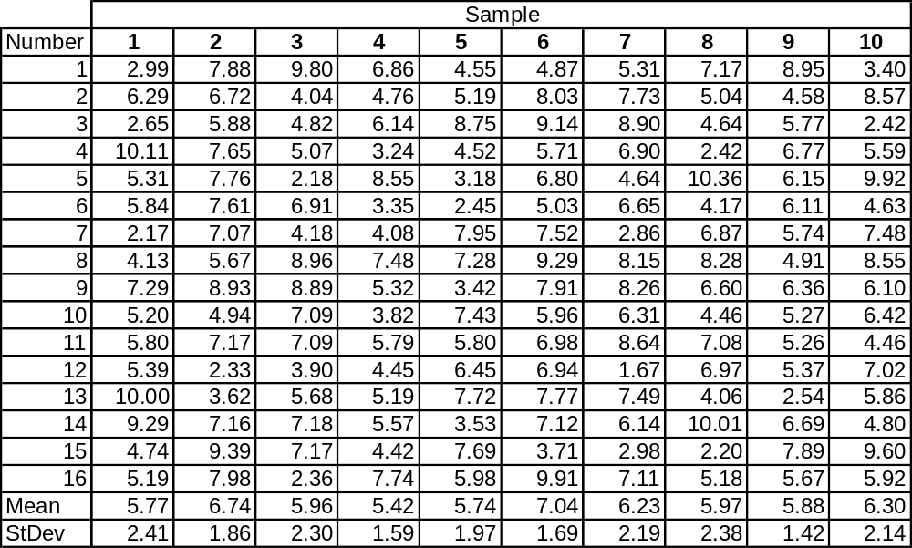
Table 3.3 Ten Random Samplings from a Normal PDF Where μ = 6 and σ = 2
Notes:
Here’s a data set we looked at numerically in Module 2, graphically in Module 3, and statistically in Module 4.
Now let’s focus on the variability, i.e. look at it “ANOVA-ly.”

Slide 6
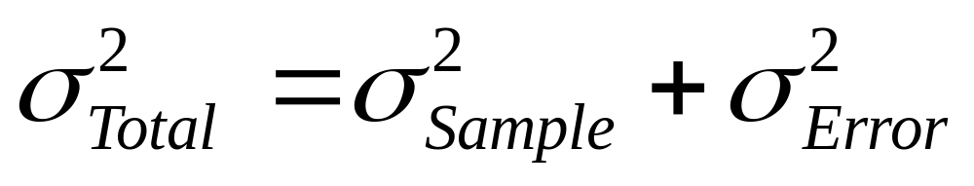

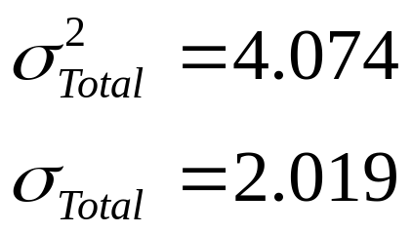
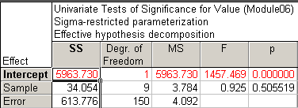
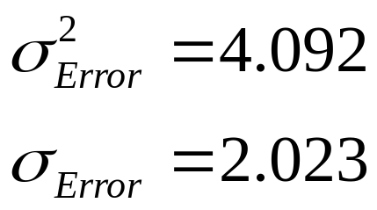

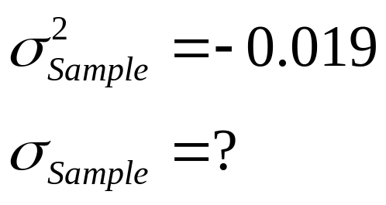
Notes:
We know that the total variation from Descriptive Statistics is 4.074.
We know that the measurement error variation from ANOVA is 4.092, but that’s greater than the total variation. How is that possible? The Sample term is not statistically significant, so it should be removed from the model and then the error variation would be equal to the total variation. But if we didn’t look at the ANOVA table, we wouldn’t know this, and we would get overly pessimistic measurement error variation estimates.
Plus, since we know that the data was randomly sampled from the same distribution Normal distribution with mean = 6 and standard deviation = 2, we wouldn’t expect otherwise.
Note: if you’re puzzled why you can get a negative value for the sample variance, don’t worry too much. This happens sometimes, and there a advanced statistical methods that restrict the variance estimates to the positive real number domain and inflate the other variance estimates so that the math works out, i.e. the Pythagorean Theorem must hold.

Slide 7
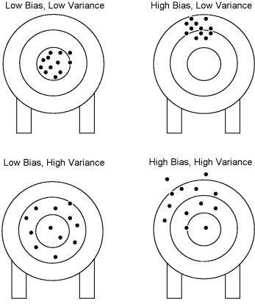
Mean or Standard Deviation Concern?
Notes:
We in comes to measurement devices, we tend to change our language.
Instead of talking about the mean, we talk about bias and use Gage Linearity studies.
And instead of working with the standard deviation, we work with the variance and use Gage Repeatability & Reproducibility (R&R) studies.

Slide 8
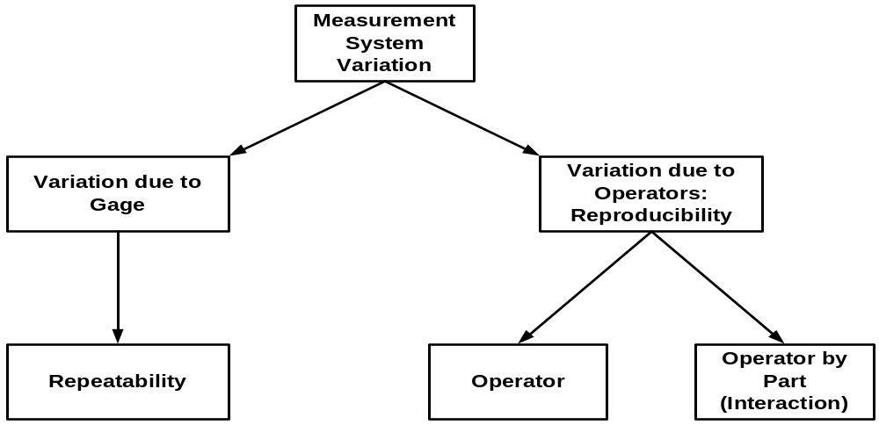
MSA Fundamentals
σ²_{Total} = σ²_{Product} + σ²_{Measurement}
Notes:
Measurement Systems Analysis (MSA)
When studying variation, good measurements are required.
Many times an evaluation of the measurement system should be performed using a gage R&R or similar study.
http://www.variation.com/techlib/val-1.html
Gage Repeatability & Reproducibility: Determine if the measurement system is adequate to measure part-to-part variability in the process
PPAP Section 4.11.4: “Evidence is required that appropriate statistical studies have been conducted to analyze the variation…”

Slide 9
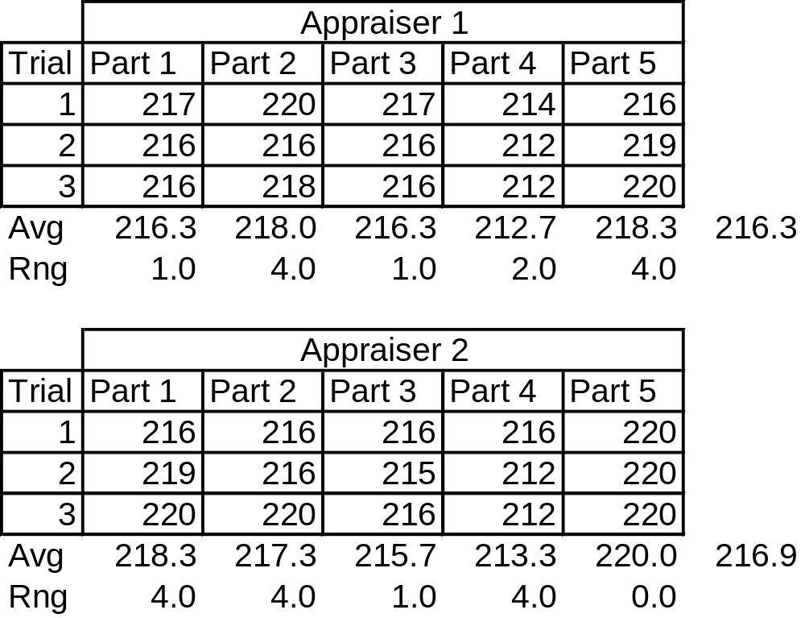
Table 12.1 Measurements for Gage R&R Example
Notes:
First create the data set from this table by putting the values in 4 columns:
Appraiser = 1, 2
Part = 1, 2, 3, 4, 5
Trial = 1, 2, 3
Measurement = the corresponding value in the table that matches the Appraiser, Part and Trial combination

Slide 10
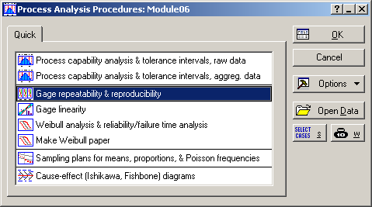
Notes:
Statistics > Industrial Statistics & Six Sigma > Process Analysis > Gage repeatability & reproducibility

Slide 11
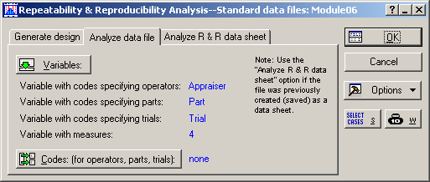
Notes:
Operators = Appraiser
Parts = Part
Trials (optional) = Trial
Measurements = Measurement

Slide 12
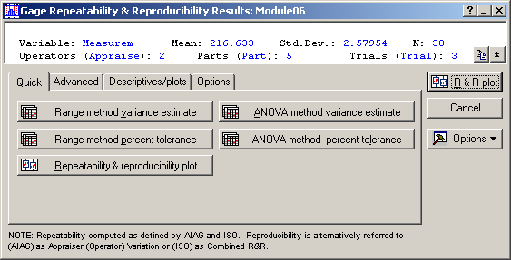
Notes:
Here’s the Quick tab menu, but we’re not going to use it.

Slide 13
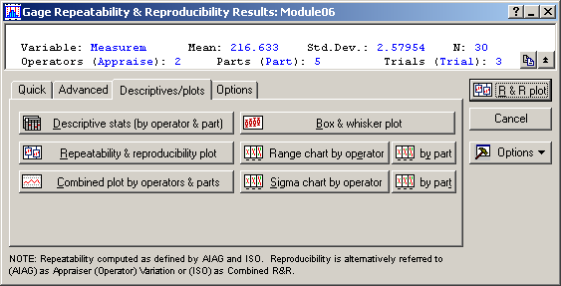
Notes:
Go to “Descriptives/plots” tab and select:
Repeatability & reproducibility plot
Combined plot by operators & parts
Range chart by operator
by part

Slide 14
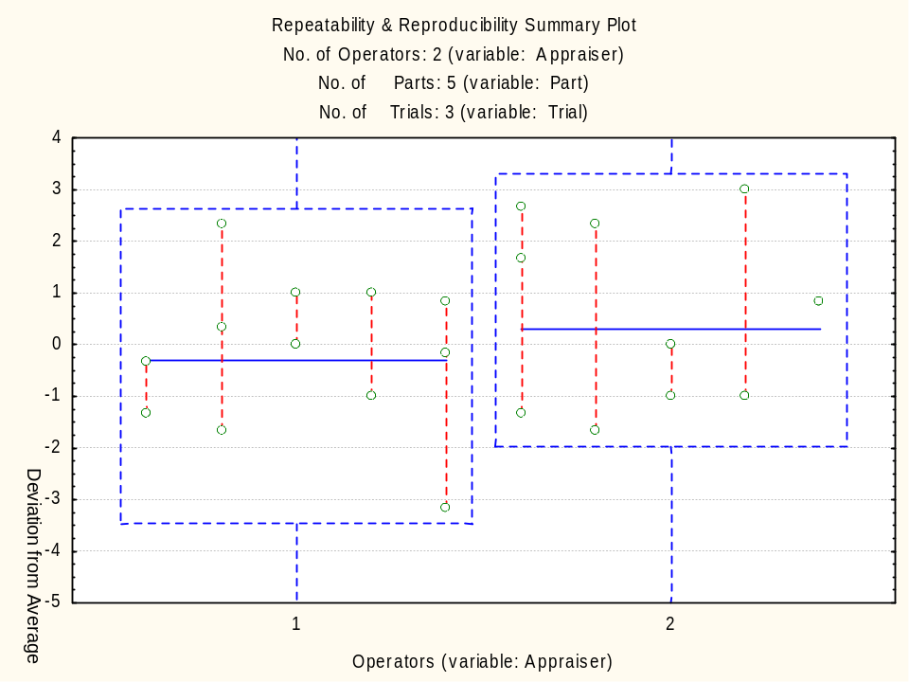
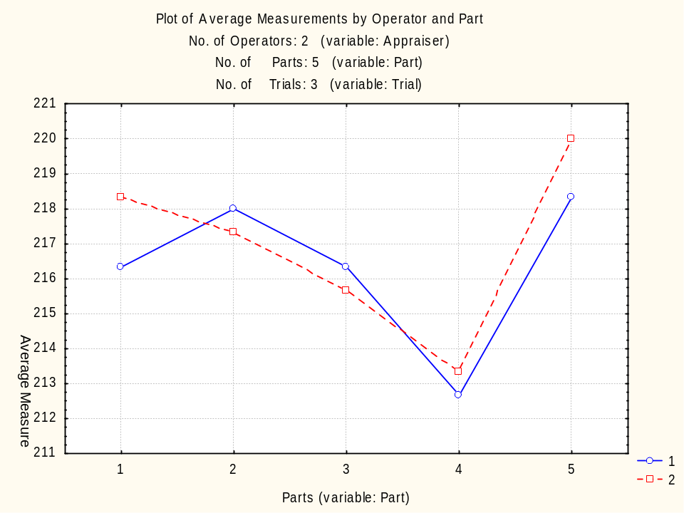
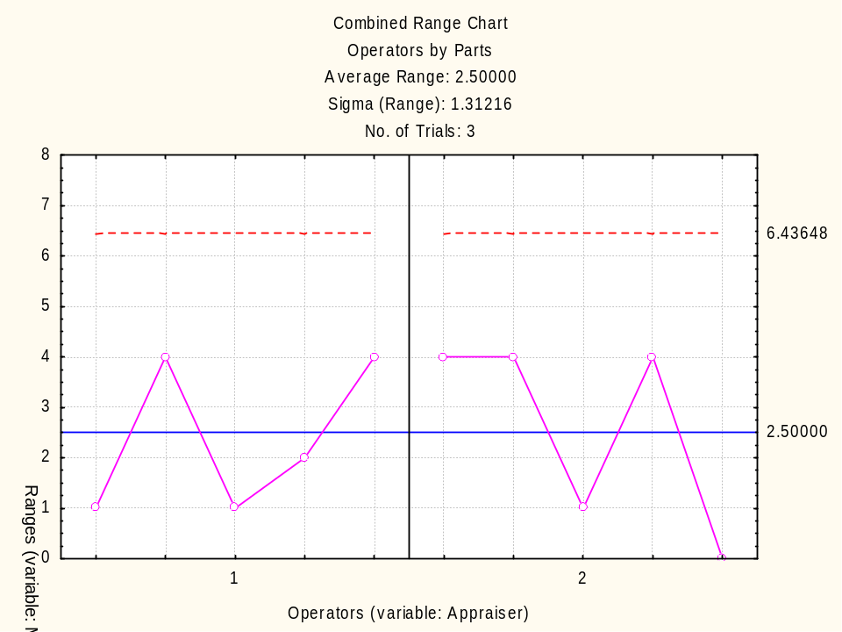
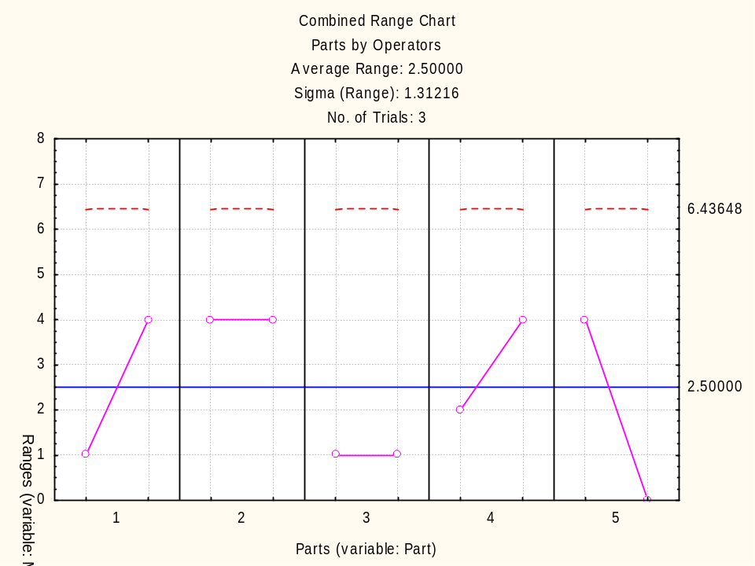
Notes:
Compare to FIGURE 12.2 Gage R&R plots.
Obviously Minitab gives different views of the data than Statistica.
This plots are mainly to explore the data (remember Exploratory Data Analysis, or EDA?) and to help diagnose problems if the results are bad.

Slide 15
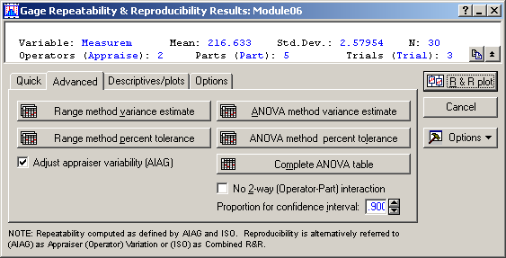
Notes:
Click “Complete ANOVA table”
Then check “No 2-way (Operator-Part) interaction” and click “Complete ANOVA table” again.

Slide 16
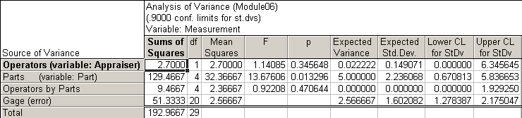
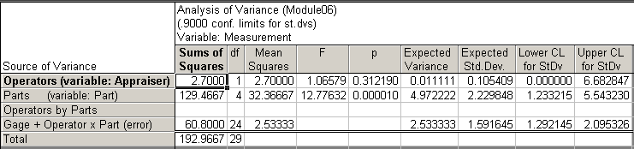
With “Operators by Parts” Interaction Term
Without “Operators by Parts” Interaction Term
Notes:
Compare the top table to the first section of the table on page 320 labeled Gage R&R Computer Output.
The “Operators by Parts” interaction is not statistically significant (p-value = 0.470644), so we can remove it.
Compare the bottom table to the second section of the table on page 320 labeled Gage R&R Computer Output.

Slide 17
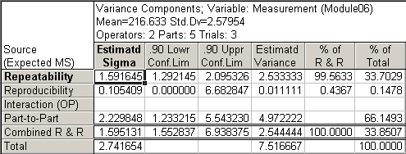
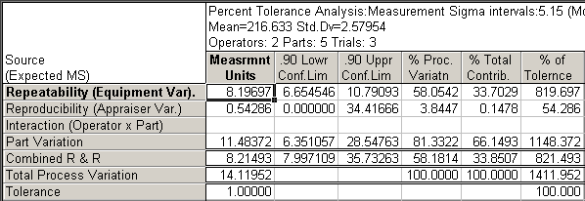
Notes:
After selecting “ANOVA method variance method” and “ANOVA method percent tolerance” you get these two tables.
Compare to the third and fourth section of the table on page 320 labeled Gage R&R Computer Output.
All the values are there and they match, but the layout is different, so they are hard to locate.
The calculations are explained on page 321. Most important, the gage variance component % = 100(2.5444/7.5167)% = 33.85%. We would like to see this at least below 30%, so the measurement system should be improvement. Until then, you should take multiple measurements of each part to reduce the effect of measurement variability (remember the Central Limit Theorem discussion?).

Slide 18
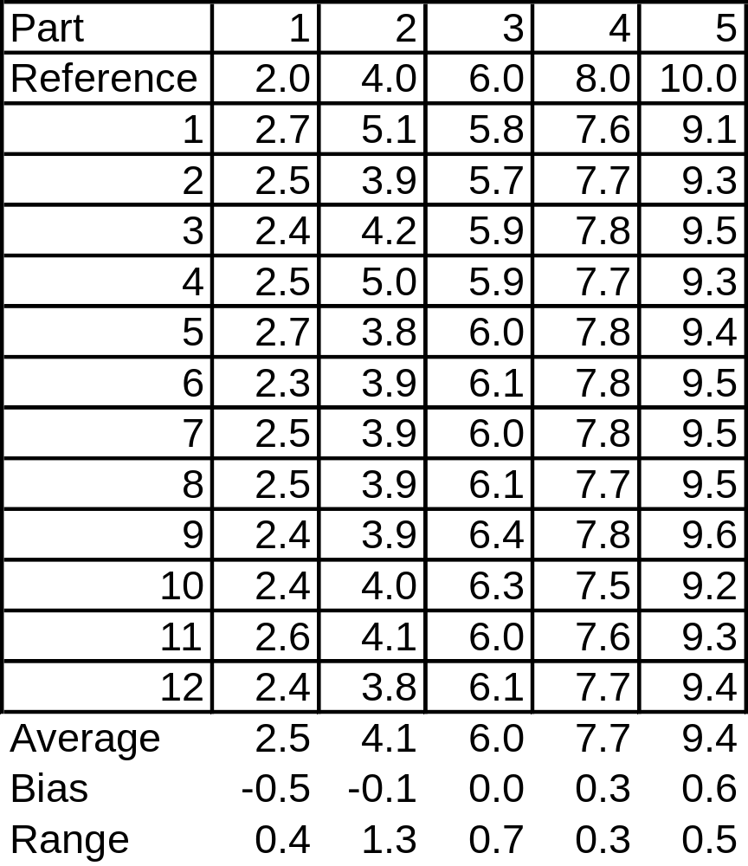
Table 12.2 Measurements for Linearity Example
Notes:
Page 323: “The five parts selected for the evaluation represent the operating range of the measurement system based upon the process variation. Layout inspection determined the part reference values. Appraisers measured each part 12 times in a random sequence.”

Slide 19
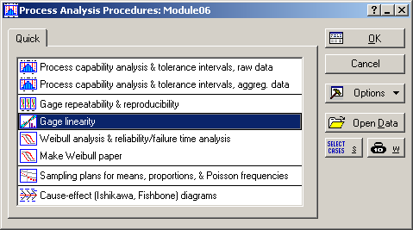
Notes:
Statistics > Industrial Statistics & Six Sigma > Process Analysis > Gage linearity

Slide 20
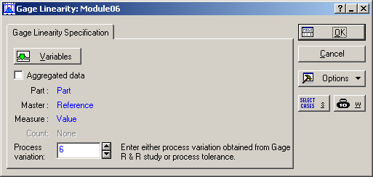
Notes:
Part = Part
Master = Reference
Measure = Value
Process variation = 6 (this wasn’t provided in the textbook, but it is in the AIAG manual)

Slide 21
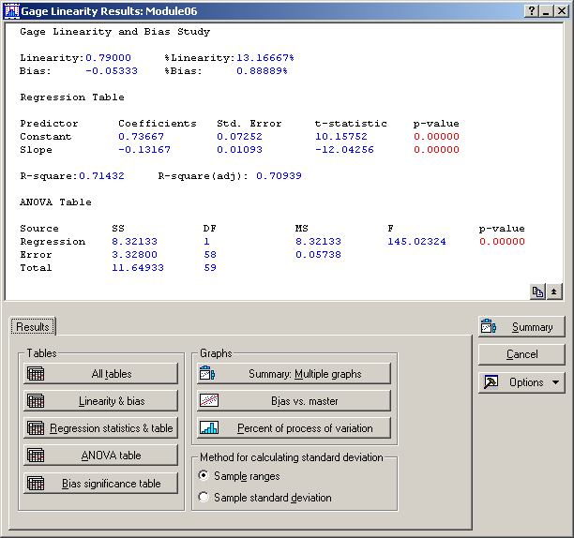
Notes:
The key numbers are already summarized in the top section of this window, but let’s look at the details.
Click the “Bias vs. master” button.

Slide 22
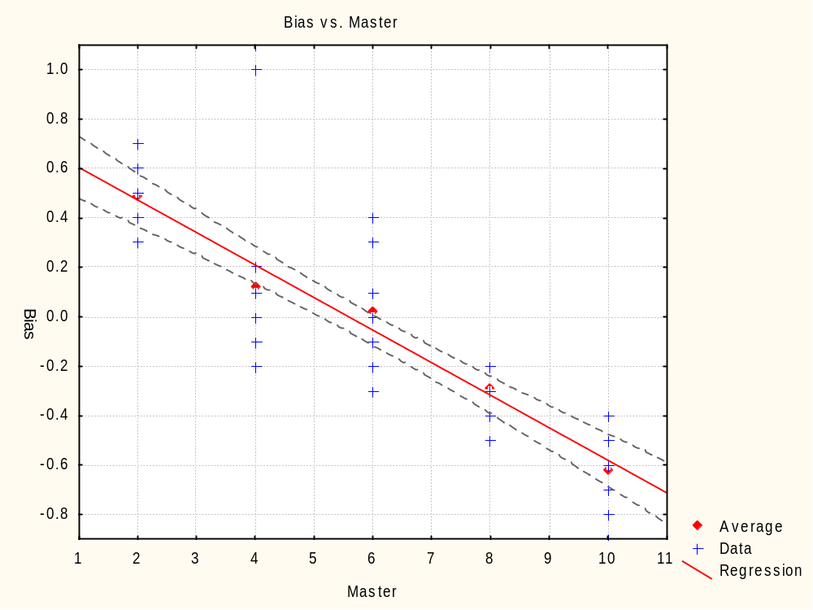
Notes:
Compare to the plot in FIGURE 12.2 Plots of gage linearity.
This plot slopes in the opposite direction, so instead of using Reference Value – Average Value, Statistica must be using Average Value – Reference Value.

Slide 23
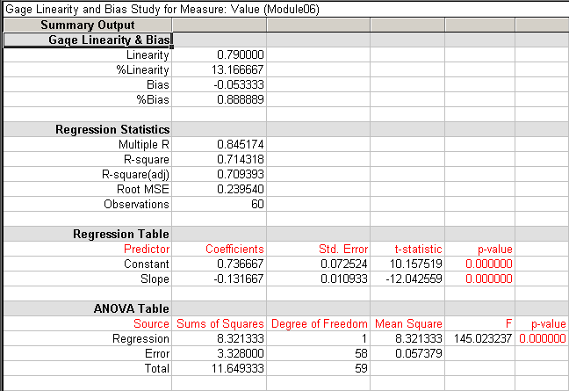
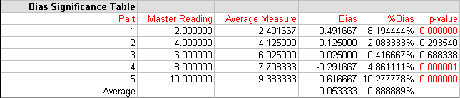
Notes:
Return to the “Gage Linearity Results” menu and click on the “All tables” button.
Compare this to the left side of FIGURE 12.2 Plots of gage linearity. The key numbers are reported in the first four rows of the table above:
Linearity = 0.79
%Linearity = 13.167%
Bias = -0.0533
%Bias = 0.889%
The ANOVA section should make look familiar, since we already covered that, but we haven’t covered the two regression sections yet, so they might not be clear.

